Slide 1
Personnel Development Program Data Collection System (PDPDCS) celia rosenquist, OSEP michelle bloom, OSEP Program coordinator Emily Hare, OSEP Program Coordinator Support
January 25, 2024

Slide 2
Training Agenda
Using the PDPDCS
Required actions for data submission
Protecting scholar data
Available resources for grantees and scholars
Questions and discussion

Slide 3
Adding New scholar records

Slide 4
Activities to complete in the PDPDCS for Enrolled Scholars
Log into the PDPDCS and verify secondary user(s)
Review your data summary
Add any new scholars
Update scholar records for each enrolled or enrolled, no longer funded scholars
Review and submit all data by April 2nd deadline
Notes:
During the data collection period, you will need to complete all of these steps and update the record for each enrolled scholar.
Although the system is available year-round, at the end of the data collection period grantees are required to have all scholar data up-to-date for all scholars who were enrolled during the previous fiscal year.
If you have not submitted all your scholars or some scholars are missing critical information, the PDPDCS Help Desk will contact you and your OSEP project officer to correct these issues immediately.

Slide 5

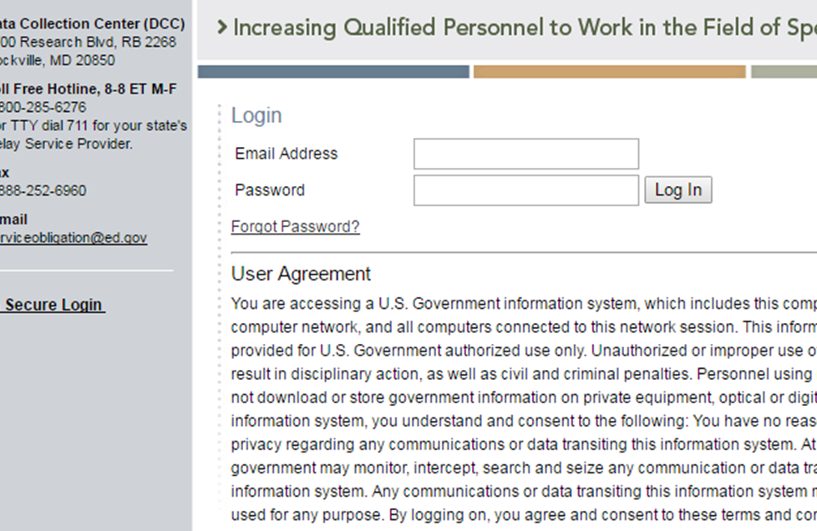
How do I reset my password?
Use the “Forgot Password” link on the login page.
Notes:
If you cannot remember your password, you will need to go to the login page to request a new password. Click “secure login” on the PDPDCS home page, then select “Forgot Password” and enter your email address. You will then receive an email from serviceobligation@ed.gov with instructions to reset your password and login again.

Slide 6
Secondary Users
Project Directors (PDs) are responsible for all data entries; however, secondary users are permitted to assist in the process.
Only three people per grant may enter or access scholar information.
Project Directors may change the secondary user(s) at any time and should review who has access at least annually.
Note: You may NOT create a shared inbox for your secondary user – each user requires a unique login.
Notes:
Remember, if you have multiple secondary users, both secondary users must have a unique login information to access the PDPDCS.
Do not create a shared inbox for additional grant users – this can create a data security issue.

Slide 7

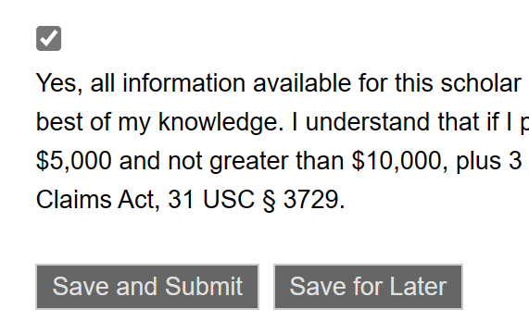

Submitting New Scholars
New OSEP PDPDCS scholars must:
Receive OSEP PDPDCS funding
Enroll in the IHE’s training program
Register for classes
Sign the PSA
Once a scholar completes these steps, grantees have 30 days to submit that scholar record
Notes:
Scholars need to complete several steps before grantees can enter them into the PDPDCS.
Scholars must receive their funding, enroll in the university’s academic training program, register for classes, and sign the digital or PDF pre-scholarship agreement (along with the project director).
Once a scholar has completed all these steps, the grantee has 30 days to submit the new scholar record in the PDPDCS. This does not have to be done prior to classes beginning for the semester.
If using the digital PSA, make sure the scholar has finished the other 3 steps before you submit the completed scholar record.

Slide 8
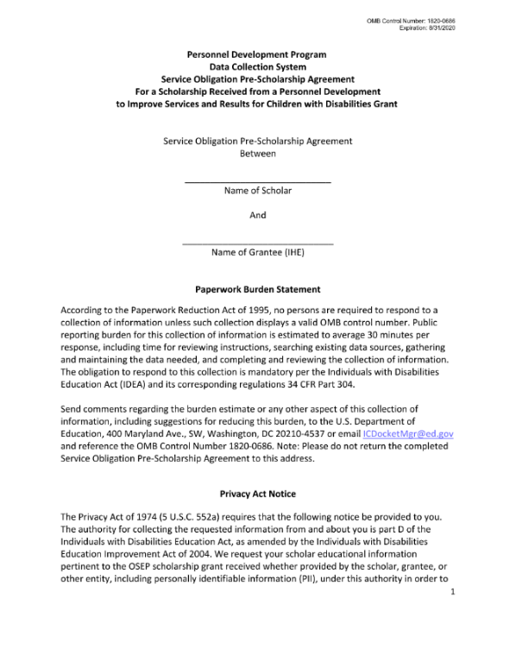
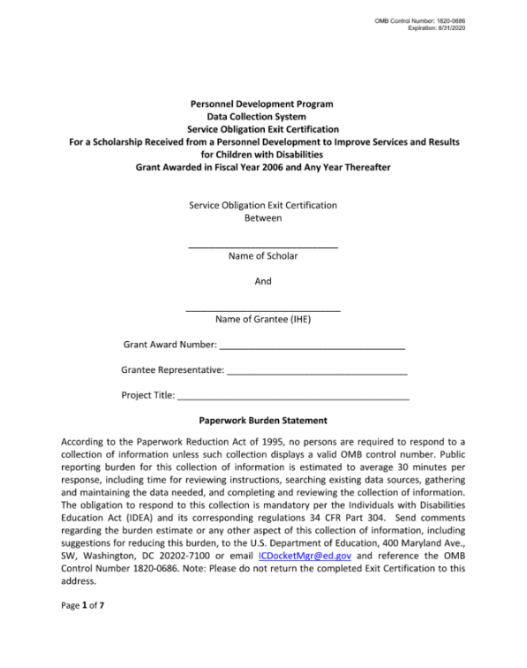
Pre-Scholarship Agreements (PSA) and Exit Certifications (EC)
Grantees and scholars must sign an OMB-approved PSA and EC for each funded scholar.
Scholar records cannot be created without a PSA.
Grantees may be held responsible for funds provided to scholars with missing or invalid documents.
Grantees must retain all grant records until each scholar’s service obligation has been fulfilled or paid back.
Digital PSA Demo Link
Notes:
When enrolling scholars, the Project Director and the scholar must both sign the Pre-Scholarship Agreement. The legally binding PSA outlines the terms and conditions of PDP funding. You, as grantees, are responsible for the accuracy and maintenance of these documents for funded scholars. If you choose to use the digital version of the PSA, please make sure you download and save a copy.
Grantees must retain grant records until all service obligation has been fulfilled or paid back. So please stay in touch with scholars until they have completed their service obligation.
In addition to the PSAs and ECs, you should disseminate to scholars' copies of the current regulations and the frequently asked questions (FAQs). Please explain clearly to your scholars these service obligation requirements before they agree to accept. Continue to remind scholars throughout the program about the requirements and that they will need to submit employment information.

Slide 9
Resources to Share with Scholars
Regulations: https://pdp.ed.gov/OSEP/Regulation/ProgramRegs2006
FAQs: https://pdp.ed.gov/OSEP/Home/faq2006
Scholar Agreements: https://pdp.ed.gov/OSEP/Home/Agreements/

Slide 10
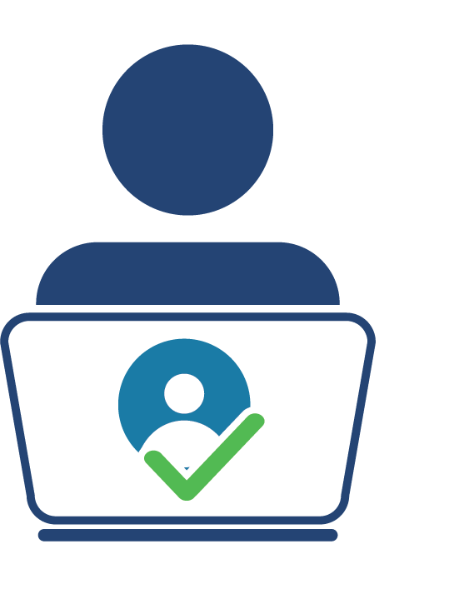
Pending Scholars
OSEP requires that scholars are in a pending status for no more than 30 days.
Help Desk staff will contact you and your Project Officer if your grant has scholars in a pending status at the end of each annual data collection period.
Notes:
Remember, scholars whose information has been entered and “saved for later” will be in a pending status. Scholar records must be “submitted” to ensure their information is complete. Clicking “save and submit” on each scholar record will allow the scholar to access their record within the PDPDCS and begin entering eligible employment, if applicable.
Scholars cannot remain in a “pending” status for longer than 30 days and scholar records cannot be “submitted” until all required items are entered.

Slide 11
Demonstration Recording
Watch a demonstration of how to update enrolled scholar records during the data collection period here.

Slide 12
Updating and exiting scholar records

Slide 13
Activities to complete in the PDPDCS Part 2
Update the training, funding, and completion status sections for each enrolled scholar:
Section G: Current Training Program Information
Section H: Employment Information During OSEP Grant Program
Section I: Scholar Status
Enter exit information for scholars no longer enrolled (Section J)
Review and submit all data by April 2nd deadline
Notes:
Once scholars have been entered into the PDPDCS, grantees will need to update scholar records at least annually during the data collection period. This includes updating the funding amounts, full or part time status, and employment during training. If a scholar has exited, then you will also need to sign and complete the Exit Certification.

Slide 14
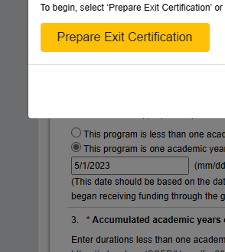
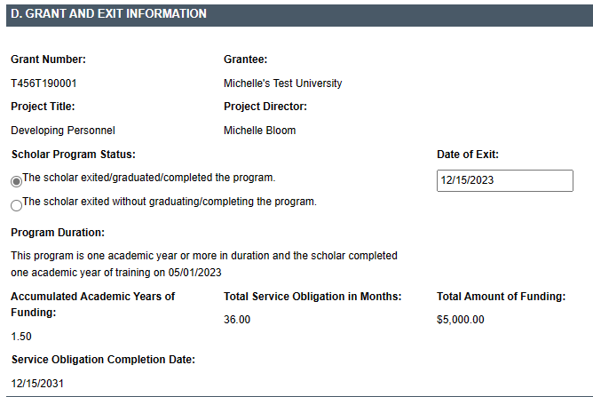
Digital EC Process
Digital EC Demo Link
Scholars are not considered exited until the EC has been signed AND the scholar’s record has been submitted.
Notes:
I want to emphasize a few points about the digital Exit Certification process. First, please make sure all information in the scholar record is accurate BEFORE beginning to prepare the digital EC, especially the date the scholar completed one academic year of training. Once you start the digital EC process, you will not be able to make edits to the record without assistance from the Help Desk.
Second, when exiting a scholar using the digital Exit Certification, there are two steps to keep in mind. Grantees must first fill out the agreement and ensure it is signed and finalized by both the PD and scholar. THEN the grantee can officially exit the scholar by completing the rest of the scholar record in the PDPDCS and submitting it.
Grantees are responsible for ensuring scholars sign either the digital or PDF version of the Exit Certification.
The scholar will remain in an “Enrolled” status until the digital EC has been signed and finalized and the grantee completes all remaining exit information data fields.
Again, PDs and secondary users can initiate the digital PSA, but only the project director can sign the final agreement.
If the estimated funding amount in the PSA differs from the final funding amount, that is fine. However, the final funding amount in the EC needs to match the funding amount shown in the PDPDCS.

Slide 15
Which program completion status should I select for my scholar?
Enrolled: The scholar is currently enrolled in the funded training program.
Enrolled, No Longer Receiving OSEP Funding: The scholar is currently enrolled in the funded training program but is no longer receiving OSEP funding.
Graduated/Completed: The scholar has completed the funded training program.
Exited without Completion: The scholar has exited the OSEP training program without completing the program.
Notes:
The status of “enrolled, no longer receiving OSEP funding” applies to scholars who may be finishing other academic requirements at the university and have completed or paused the program. This refers to scholars who are not currently receiving any PDP funding but have not yet graduated or completed the training program.
The graduated/completed status refers to scholars who completed the training program and typically have graduated from the university.
If you select the exited without completion status, the PDPDCS will prompt you to include a reason for the scholar’s exit. Possible reasons include transfer to another program, health, poor academic performance, OSEP grant ending, and more. You will need to indicate the date of exit without completion and whether the scholar is expected to enroll in another OSEP grant program in the future.

Slide 16

Timeline for Updating and Exiting Scholars
Update scholar contact and program completion information within 30 days of:
Scholar status changing from enrolled to
Enrolled but no longer funded,
Exited Prior to Completion, or
Graduated
Grant budget period ending
Notes:
Apart from the updates required during the data collection period, grantees’ must also update scholars’ information within 30 days of a change in a scholar’s status.
For example, you will need to change the scholar’s status in the PDPDCS within 30 days of that scholar graduating or exiting prior to completing the program. If that 30 days falls within the data collection period, you can make these updates at the same time.

Slide 17

Measure of Knowledge and Skills
Completed/graduated scholars are required to fulfill a measure demonstrating knowledge and skills in evidence-based practices for children with disabilities
Options for measures:
Grantee-specific tests (e.g., portfolio, comprehensive exam, dissertation defense)
PRAXIS II
National organization tests
State-specific tests
Capstone project or exam
Notes:
When a scholar graduates or completes the program, grantees will need to indicate which measure of knowledge and skills a scholar fulfilled and whether they passed. Grantee responses to this question are essential in that this data is reported to Congress.
We will share a full list of the acceptable measures in a new resource after this presentation. Unacceptable measures for this question include entrance exams and individual course exams or grades.
If you do not know which measure scholars are fulfilling upon completing the program, or are unsure if it is an acceptable measure, please contact the Help Desk. It is only under extenuating circumstances that a scholar would not have taken a measure of knowledge and skills.
We recommend that you conduct an exit interview with each scholar to collect this information BEFORE they leave the program.
Grantees are only required to enter one measure of knowledge and skills; however, we encourage you to add more. If you have exited the scholar and then learned about additional measures, please contact the Help Desk to update this information for you.

Slide 18
Exit All Scholars BEFORE Your Grant Ends
Any scholar who has not graduated/ completed or previously exited when the grant closes will need a status of “exited without completion.”
Project Directors are responsible for obtaining Exit Certifications from these scholars too. Service obligation requirements still apply.
As you “exit” each scholar, you will report the reason or final status for each scholar.
End of grant checklist
Notes:
When OSEP funding ends, at the conclusion of a grant, it is the responsibility of the grantee to “exit” all scholars in PDPDCS. Grantees will “exit” scholars either as graduated/completed or exited without completion for a specific reason. If you choose “exited without completion” because your grant has ended, please select the option “OSEP support terminated due to OSEP grant ending.”
ALL scholars MUST sign an Exit Certification upon exiting the program and grantees MUST exit all scholars before submitting the Final Performance Report.
PDPDCS staff will work with grantees and OSEP to assist in making sure all scholars are in an “exited” status at this time.
Please utilize the end-of-grant checklist for grantees to help you understand what is required to begin the process to close-out your grant. This checklist can also be found on the training page.

Slide 19
Managing PDPDCS Grants and Timelines
Project Directors must manage grants to ensure that:
All scholars can complete the degree program before the grant ends;
Scholars are enrolled early (Year 1) with sufficient time, funding, and support to complete the program; and
The number of scholars proposed, enrolled, and completed meets outlined expectations.
Contact your OSEP Project Officer to discuss changes in the number of or completion status of scholars.
Notes:
It is up to the grantee to ensure that scholars are enrolled with enough time, funding, and support to complete the training program within the grant project period. You need to manage the grant so that all scholars complete the program before the grant ends.
We want projects to end within the established grant project period. OSEP may consider grantees request for a one-time, no cost extension to allow more time –up to 12 months, no new money– for scholars to complete the preparation program and graduate. We want scholars to “complete” the program and be counted as program completers! Please make sure you are making these timing considerations when recruiting.

Slide 20
Submit Data for ALL Scholars by April 2nd
Federal Regulations:
According to 34 CFR 75.253(a)(3), the timely submission of this report is one of the factors that the Secretary will consider in determining whether to continue your project's funding for the next fiscal year
According to section 75.217(d)(3)(ii), the Secretary can consider the failure to submit scholar data in a timely fashion in determining your project’s ability to obtain future grants from the Office of Special Education Programs or under any other Department program.
Notes:
Make sure that by the deadline of April 2nd, 2024, you have entered and submitted records for all currently enrolled scholars (meaning scholars who enrolled before April 2nd) AND updated the records for scholars who have graduated or exited prior to completion.
Again, if you have scholars that are in a “pending” status or scholars that are “enrolled” or “enrolled, no longer funded” at the end of the data collection period, PDPDCS will notify you and your OSEP project officer. All noncompliant grantees will be reported to OSEP. Project Officers will then contact those project directors to determine what barriers are preventing the grantee from submitting their scholar data as required and in a timely manner.
Please remember that the Secretary can consider failure to submit scholar data in a timely fashion in determining your project’s ability to obtain future grants from OSEP or under any other Department program.
If you have any questions about submitting data or using the PDPDCS, you can always contact the Help Desk and one of our associates would be happy to help you!

Slide 21
Demonstration Recording 1
Watch a demonstration of how to update graduating or exiting scholar records here.

Slide 22
Avoiding Security Incidents

Slide 23

Security Incidents
A security incident occurs if personally identifiable information (PII) is potentially viewable to unrelated parties.
Examples from PDPDCS:
Uploading an unredacted Pre-Scholarship Agreement (PSA) to the wrong scholar record
Sending unencrypted documents (Social Security Card, Driver’s License, etc.) in an email to the PDPDCS Help Desk
Notes:
Scholar agreements and records within the PDPDCS contain significant amounts of scholar’s personally identifiable information (PII). It is the responsibility of the grantees to protect this scholar information. Improperly handling PDP documentation could expose a scholar to potential identity theft and impact the university’s ability to receive future funding from the Department.
We recommend using the digital PSA feature to avoid potentially uploading an unredacted document to an incorrect scholar record.

Slide 24
Impacts of Security Incidents on Department Staff
PDPDCS staff must notify the Department’s Education Security Operation Center (EDSOC), document the incident, and expunge the file or email from the servers
Additional interviews, investigations, and mitigation strategies may be necessary
PDPDCS Staff must review all other scholar records and documentation associated with the grantee
Notes:
Every security incident that occurs requires significant resources from the Department to mitigate the impact. These steps require hours of paperwork and Department resources to address. Further, we all want to do our part to protect PII of scholars.

Slide 25
Impacts of Security Incidents on Grantees
Grantees must resubmit scholar documentation, complete security incident report, and participate in investigation interviews as needed
Project Directors and Secondary Users will be required to participate in a security training to understand the proper handling of scholar PII and the consequences of data breaches
The grant will be placed on a security incident list tracked by PDPDCS and OSEP staff. If further incidents occur, the grant and university could be placed on high-risk status, impacting their ability to receive future federal funding
Notes:
In addition to the potential effects of sharing PII, grantees may also encounter these consequences as result of one or multiple security incidents.

Slide 26
How to Avoid Security Incidents
Always encrypt files being sent by email, including to the PDPDCS Help Desk.
Use the digital Pre-Scholarship Agreements and Exit Certifications to avoid uploading a document to the wrong scholar record.
Implement a file naming convention to track files associated with each scholar’s record: PSA_J_DOE.pdf.

Slide 27
Security Incident Resources
What are PDPDCS Security Incidents?
How to Encrypt Files

Slide 28
Scholar faqs

Slide 29
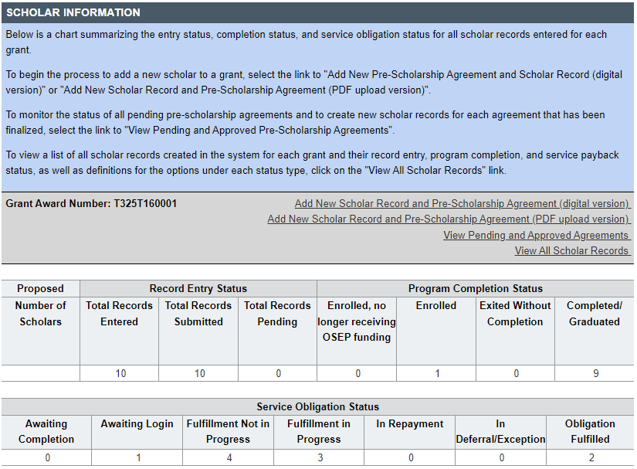
How do I know if my scholars have logged into the PDPDCS?
Notes:
You should monitor the service obligation status of all scholars in your program using the summary tables that display counts of scholars in each service obligation status. Under the service obligation status header, you will be able to easily see the number of scholars not yet logged in or begun fulfilling their service obligation. If a scholar has a status of “fulfillment not in progress”, this means either the scholar has not yet entered employment information into the PDPDCS, or the scholar has submitted an employment record, but it has not yet been verified by their employer.
An explanation of the other statuses is listed at the top of View All Scholar Records page. Grantee support will ensure OSEP has the data it needs to report on PROGRAM Performance Measures and service obligation results to Federal government authorities.

Slide 30
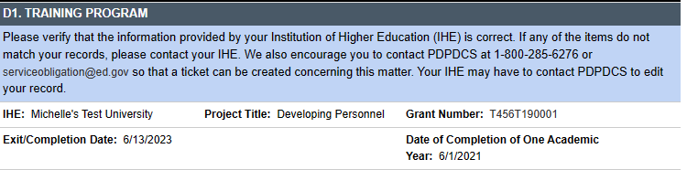
What do I need to tell scholars?
After one academic year, scholars may begin fulfilling their service obligation
Scholars must repay their scholarship monetarily if exiting prior to completion of one academic year
Scholars should update employment information every 6 months
Read all emails from serviceobligation@ed.gov
Notes:
Scholars must complete 1 academic year before they may begin to fulfill their obligation through service. Exiting prior to one academic year of enrollment in program requires a cash payback. The screenshot on the slide shows the scholar view of the PDPDCS and indicates where scholars can see the date of completion of one academic year.
Grantees are responsible for updating the PDPDCS with the date that their scholars have completed one academic year. If you do not update scholar records with this date, scholars will not be able to enter their employment information at the one-year mark.
We also recommend that scholars login to update their employment information every 6 months to ensure it is accurate.
Lastly, please make sure you and your scholars are reviewing all emails from serviceobligation@ed.gov. This is how the PDPDCS communicates with grantees and scholars. We recommend adding this address to your contact list.

Slide 31
When should scholars log in?
Scholars must login to the PDPDCS within 30 days of receiving access to the system and then should continue to do so every 6 months until they fulfill their service obligation to:
Review and update contact information;
Review training and service obligation information; and
Submit employment information.
Notes:
You know and see your scholars, so remind them that once they receive the email with instructions for accessing the PDPDCS (which is sent to them as soon as you “submit” their record in the system), they need to login. Scholars must login to the PDPDCS during enrollment to ensure they can access the system prior to exiting or graduation.
Continue to talk with your scholars throughout the program about their service obligation. Inform them and remind them of the need for them to (a) enter employment information and (b) ask their employer to login and verify their employment so they can begin fulfilling their service obligation.
Our Help Desk has received many questions about this: The service obligation calculator will only update once employers complete the verification process. Only previously completed employment can be credited towards the service obligation. We recommend scholars login every 6 months to update their employment to display an accurate status.

Slide 32

What information goes into the employment record?
Information collected includes:
Contact information;
Type of organization;
Dates of employment;
Type of employment;
Full or part time position;
Training area(s);
Whether the position meets PDPDCS time requirements; and
Certification or licensure.
Notes:
Scholars are responsible for entering their employment information, but grantees can answer questions or assist if needed. Grantees cannot access scholar employment records. Scholars can always be directed to contact the Help Desk with any questions.

Slide 33

What if scholars don’t get employment verification?
Scholars are responsible for ensuring their submitted employment is reviewed and verified by their employer.
Scholars who do not have their employment verified by the time their service obligation must be fulfilled will be referred to ARBMD for cash payback.
Notes:
Scholars who do not submit eligible employment information that is verified by their employer by the time their service obligation must be fulfilled are not in compliance and will be referred to the Accounts Receivable and Banking Management Division, ARBMD, for repayment.
Again, the service obligation calculator will only update once employers verify a scholar’s employment record, so please remind your scholars to update their employment every 6 months to display an accurate status.
The burden to ensure that scholars receive credit for their obligation falls onto SCHOLARS. Once you have exited a scholar, you will no longer be able to make changes to that scholar record. You should remind scholars to login and complete their employment records, but they must ensure their employment is verified in the system to receive service obligation credit. At this time, the OSEP PDPDCS does not send reminders to scholars to resubmit their employment, so scholars should not expect these.
Both legal and ethical issues are associated with service obligation, and we encourage you to talk with scholars about the importance you place on fulfilling this professional obligation.

Slide 34
Resources and Support

Slide 35

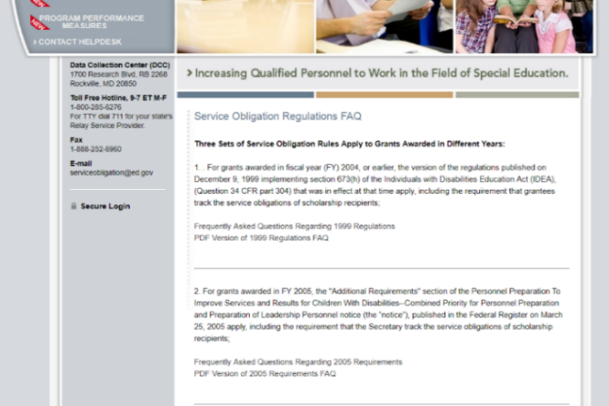
Finding PDPDCS Resources
PDPDCS resources include:
(https://pdp.ed.gov/OSEP/Home/Training)
Annual Webinar Recordings
Annual and Final Checklists
Digital PSA and EC Info
Scholar Webinar Recording
Employer Tip Sheet
MFA Training PPT/Video
PDPDCS Frequently Asked Questions (https://pdp.ed.gov/OSEP/Home/dcsfaq)

Slide 36
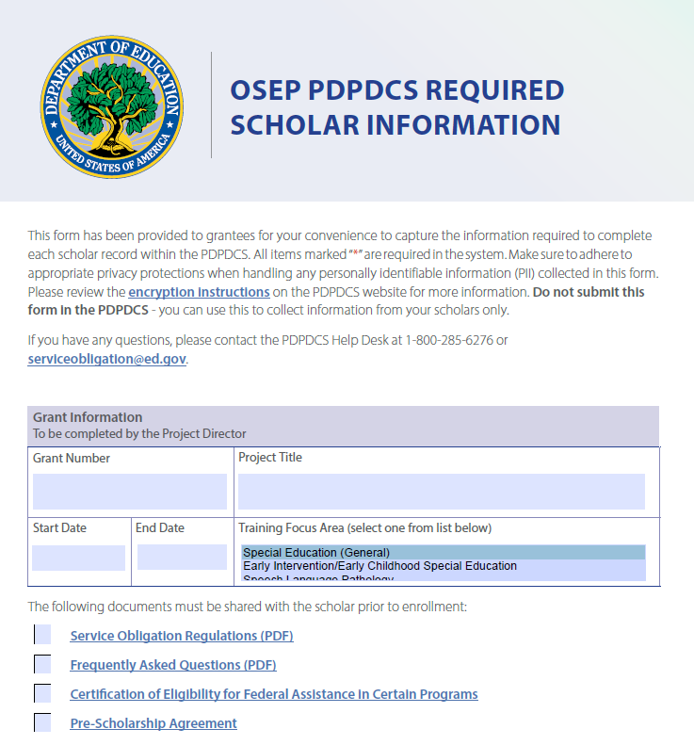
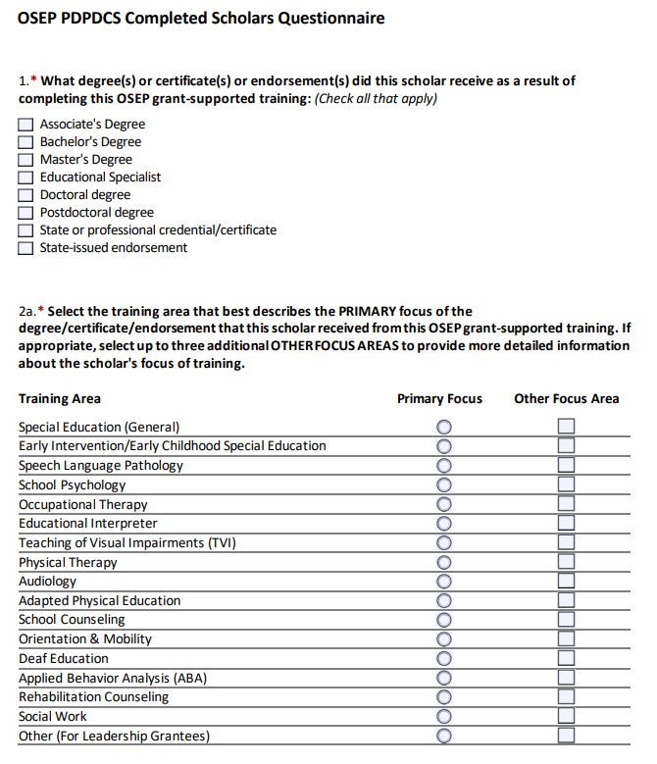
New Data Collection Resources
Notes:
You may remember the Required Scholar Information Resource from last year for collecting data from scholars at the beginning of their program enrollment. We have also created another resource to assist grantees with data entry when scholars graduate from or complete the program.
Both documents are fillable PDFs you can send to scholars to have them enter their contact information. If you choose to utilize this tool, you must adhere to privacy protections. We recommend using encryption or password protection when sending this document back and forth. Please DO NOT send this document to the Help Desk.
Once you have gathered the information from the scholar in this document, you can then use it to complete the scholar’s record in the PDPDCS and submit it.
We will share this resource via email with you after the presentation and it will be posted on the website very soon.

Slide 37
Questions and Discussion
More questions?
PDPDCS Help Desk
Support available from 8 am to 8 pm EST
Monday through Friday
1-800-285-6276
For TTY dial 711 for your state’s Relay Service Provider
serviceobligation@ed.gov

